Slide 1

COMPUTER NETWORKS
(BCSC 0008)
Copyright content, use only with the written permission of presenter mentioned
Lecture- 6 & 7
DATA & SIGNALS

Slide 2
Text and Reference Books
Text Books:
Fourouzan B. A. (2004), “Data Communication and Networking”, 4th Edition, McGraw-Hill.
References:
Kurose, J. F. and Ross K. W. (2005), “Computer Networking: A Top-Down Approach Featuring the Internet”, 3rd Edition, Addison-Wesley.
A. S. Tanenbaum (2006), “Computer Networks”, 2nd Edition, Prentice Hall India.

Slide 3
Previous discussed topics:
  OSI Model
  TCP/IP Model
  Addressing
Now we will discuss:
  Data & Signals
  Periodic Analog Signals & Digital Signals
  Transmission Impairments
  Latency

Slide 4
Analog and Digital Data
Data can be analog or digital.
The term analog data refers to information that is continuous; For example, an analog clock that has hour, minute, and second hands gives information in a continuous form; the movements of the hands are continuous.
On the other hand, digital data refers to information that has discrete states. For example, a digital clock that reports the hours and the minutes will change suddenly from 8:05 to 8:06.

Slide 5
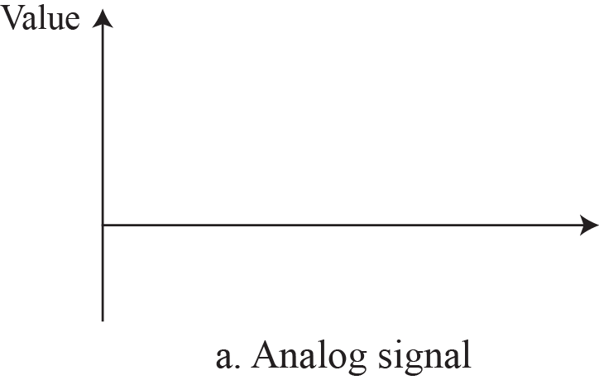

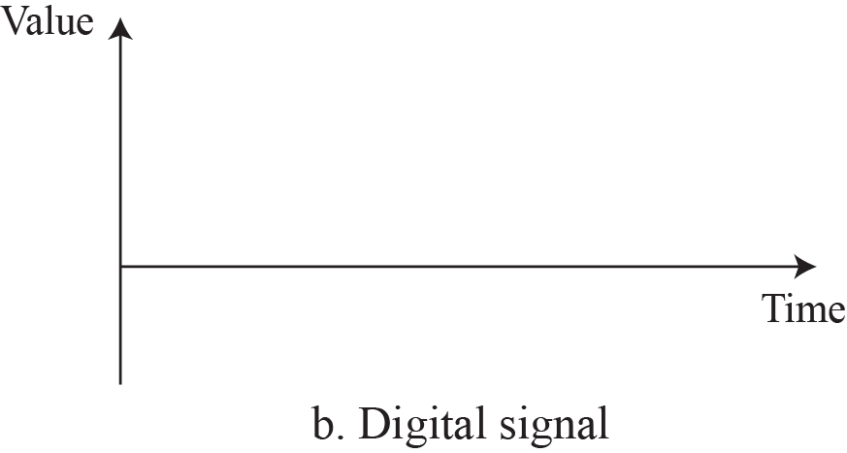

Comparison of analog and digital signals

Slide 6
Periodic and Nonperiodic
A periodic signal completes a pattern within a measurable time frame, called a period, and repeats that pattern over subsequent identical periods. The completion of one full pattern is called a cycle.
A non periodic signal changes without exhibiting a pattern or cycle that repeats over time. Both analog and digital signals.
The sine wave is the most fundamental form of a periodic analog signal.

Slide 7
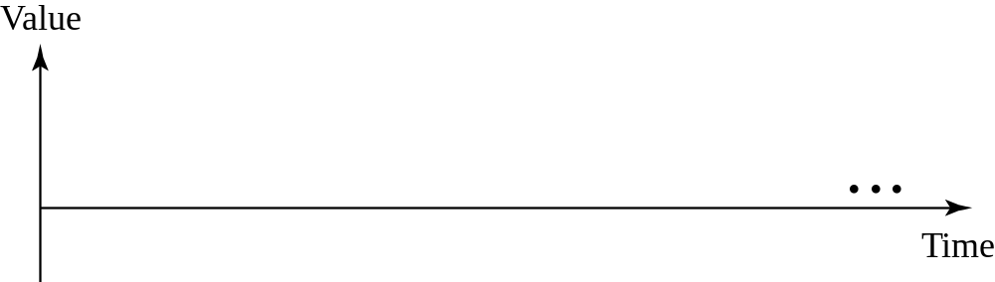

A sine wave
The sine wave is the most fundamental form of a periodic analog signal.

Slide 8
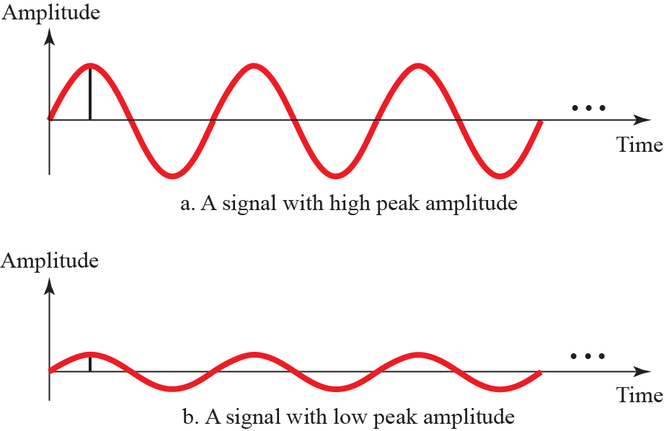
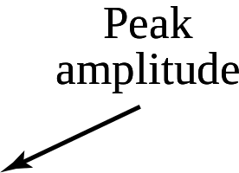
Two signals with two different amplitudes

Slide 9
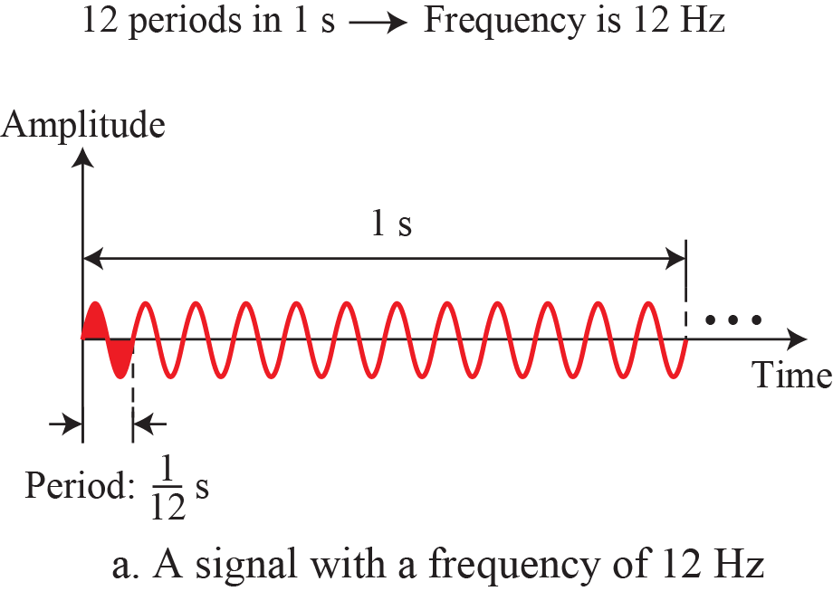
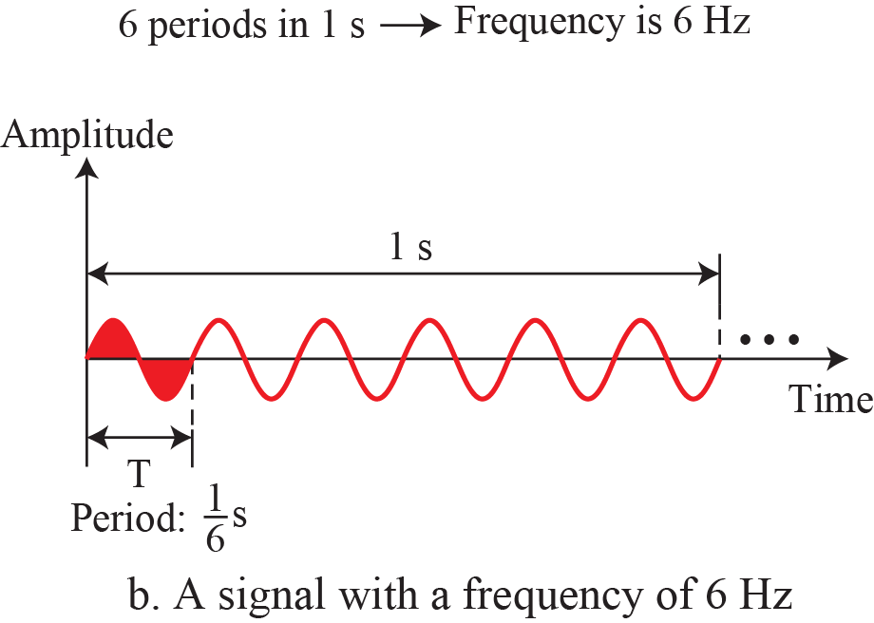
Two signals with same phase, different amplitudes and frequency

Slide 10
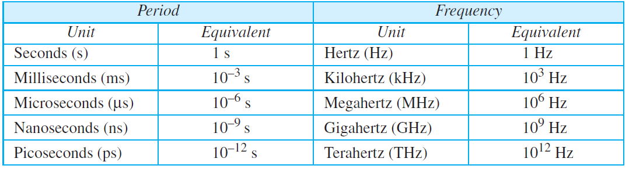
Units of period and frequency

Slide 11
Example 1
Express a period of 100 ms in microseconds.
Solution
The equivalents of 1 ms (1 ms is 10–3 s) and 1 s (1 s is 106 μs). We make the following substitutions:

Slide 12

Example 2
The power we use at home has a frequency of 60 Hz (50 Hz in Europe). The period of this sine wave can be determined as follows:
This means that the period of the power for our lights at home is 0.0116 s, or 16.6 ms. Our eyes are not sensitive enough to distinguish these rapid changes in amplitude.

Slide 13
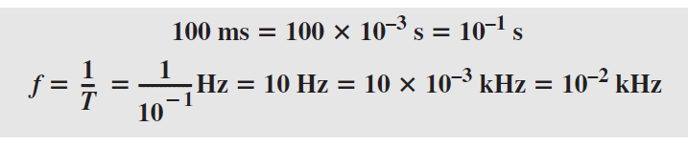
Example 3
The period of a signal is 100 ms. What is its frequency in kilohertz?.
Solution
First we change 100 ms to seconds, and then we calculate the frequency from the period (1 Hz = 10^{–3} kHz).

Slide 14
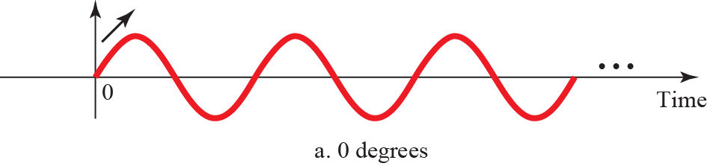
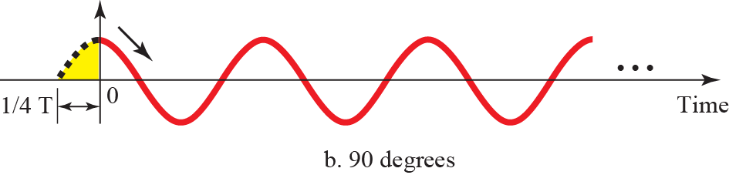
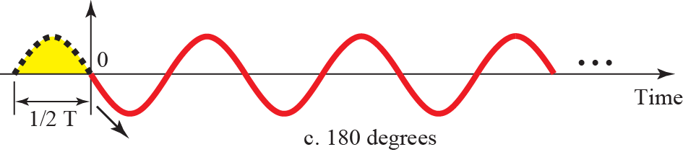
The term PHASE, or PHASE SHIFT, describes the position of the waveform relative to time 0

Slide 15


WAVELENGTH binds the period or the frequency of a simple sine wave to the propagation speed of the medium

Slide 16
Application of Simple Signals
Simple sine waves have many applications in daily life.
We can send a single sine wave to carry electric energy from one place to another. For example, the power company sends a single sine wave with a frequency of 60 Hz to distribute electric energy to houses and businesses.
As another example, we can use a single sine wave to send an alarm to a security center when a burglar opens a door or window in the house. In the first case, the sine wave is carrying energy; in the second, the sine wave is a signal of danger.

Slide 17
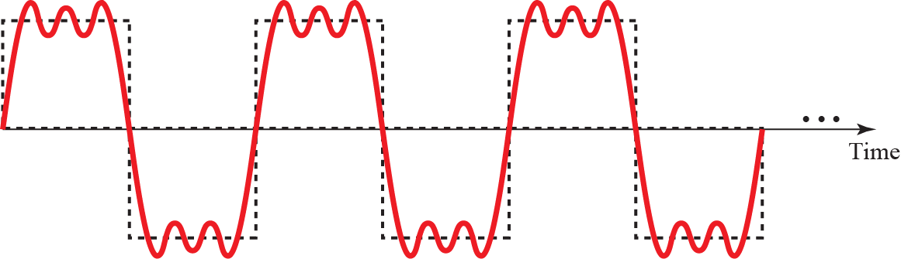
Composite Period Signal
A Composite Signal is collection of multiple single simple signals

Slide 18
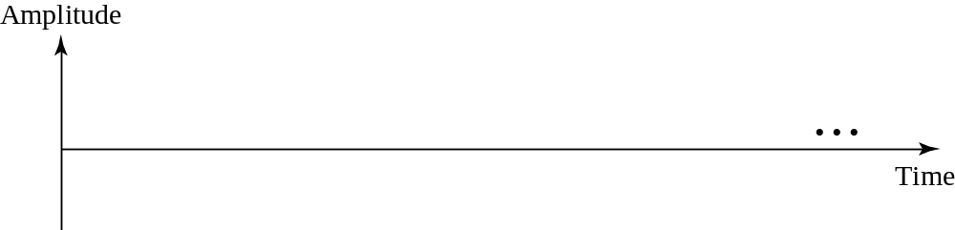

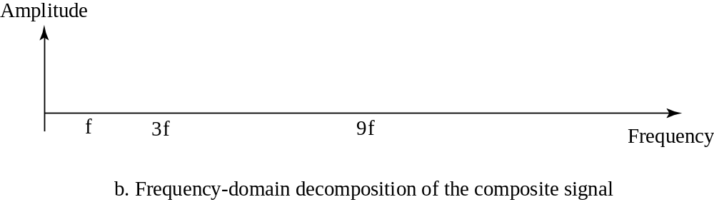
Decomposition of a composite periodic signal

Slide 19
Bandwidth
The range of frequencies contained in a composite signal is its bandwidth. The bandwidth is normally a difference between two numbers. For example, if a composite signal contains frequencies between 1000 and 5000, its bandwidth is 5000 − 1000, or 4000.

Slide 20
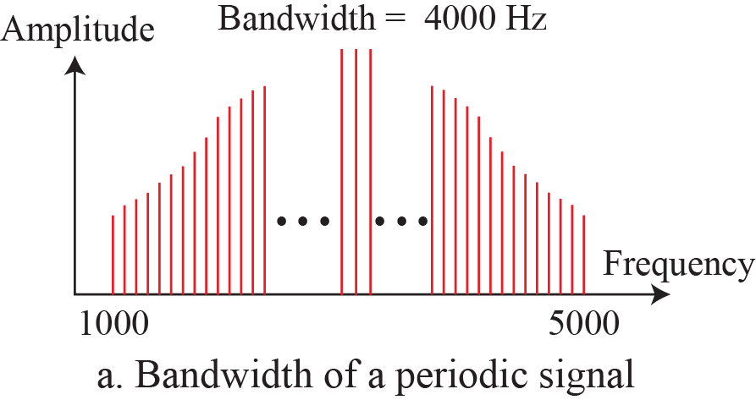
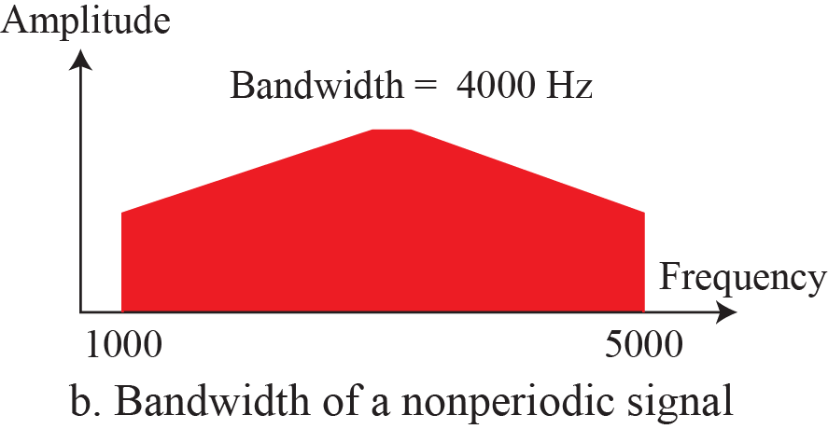
Figure 3.13: The bandwidth of periodic and nonperiodic composite
signals

Slide 21

Example 4
If a periodic signal is decomposed into five sine waves with frequencies of 100, 300, 500, 700, and 900 Hz, what is its bandwidth? Draw the spectrum, assuming all components have a maximum amplitude of 10 V.
Solution
Let f_{h} be the highest frequency, f_{l} the lowest frequency, and B the bandwidth. Then

Slide 22
Example 5
A periodic signal has a bandwidth of 20 Hz. The highest frequency is 60 Hz. What is the lowest frequency? Draw the spectrum if the signal contains all frequencies of the same amplitude.
Solution
Let f_{h} be the highest frequency, f_{l} the lowest frequency, and B the bandwidth. Then
The spectrum contains all integer frequencies. We show this by a series of spikes (see Figure 3.15).

Slide 23
Digital Signals
In addition to being represented by an analog signal, information can also be represented by a digital signal. For example, a 1 can be encoded as a positive voltage and a 0 as zero voltage. A digital signal can have more than two levels. In this case, we can send more than 1 bit for each level. Next figure shows two signals, one with two levels and the other with four.
A digital signal is a composite analog signal with an infinite bandwidth which is limited by the bandwidth of the medium

Slide 24
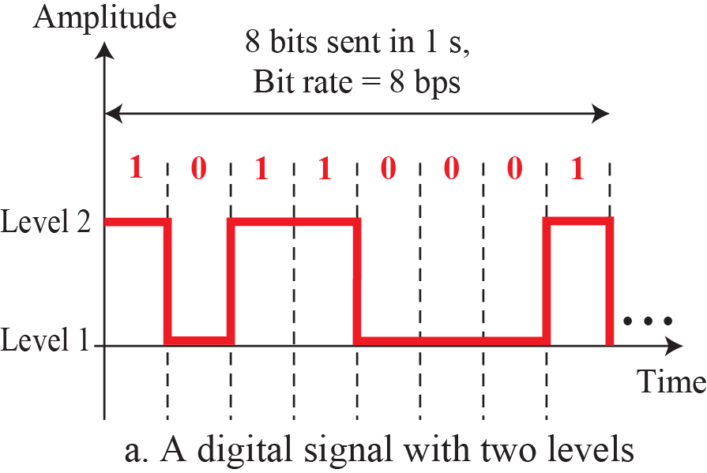
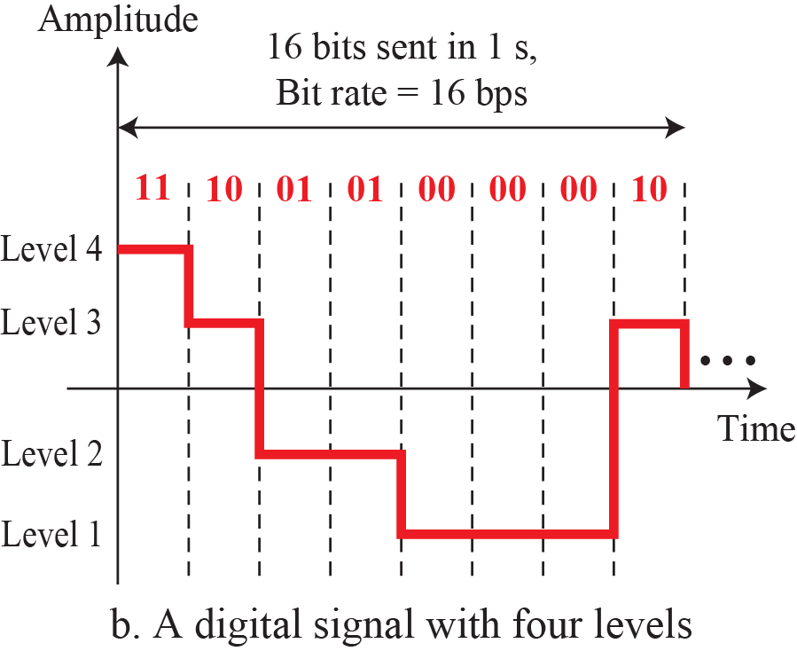
Two digital signals: one with two signal levels and the other with four signal levels

Slide 25

Example 6
A digital signal has eight levels. How many bits are needed per level? We calculate the number of bits from the following formula. Each signal level is represented by 3 bits.

Slide 26
Example 7
A digital signal has nine levels. How many bits are needed per level? We calculate the number of bits by using the formula. Each signal level is represented by 3.17 bits. However, this answer is not realistic. The number of bits sent per level needs to be an integer as well as a power of 2. For this example, 4 bits can represent one level.

Slide 27
Bit Rate
Most digital signals are non periodic, and thus period and frequency are not appropriate characteristics. Another term Bit Rate (instead of frequency) is used to describe digital signals. The bit rate is the number of bits sent in 1s, expressed in bits per second (bps).

Slide 28
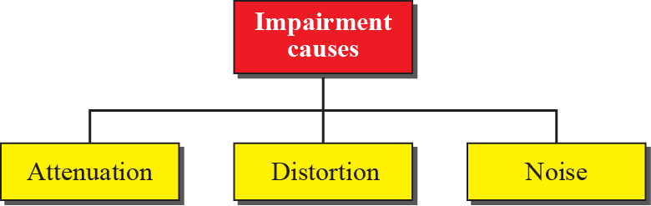
Transmission Impairment
Signals travel through transmission media, which are not perfect. The imperfection causes signal impairment. This means that the signal at the beginning of the medium is not the same as the signal at the end of the medium. What is sent is not what is received. Three causes of impairment are attenuation, distortion, and noise

Slide 29

Attenuation
Attenuation means a loss of energy. When a signal, simple or composite, travels through a medium, it loses some of its energy in overcoming the resistance of the medium. That is why a wire carrying electric signals gets warm, if not hot, after a while. Some of the electrical energy in the signal is converted to heat. To compensate for this loss, amplifiers are used to amplify the signal. Next figure shows the effect of attenuation and amplification.
Decibel (dB) is used to measure the attenuation.
dB=

Slide 30
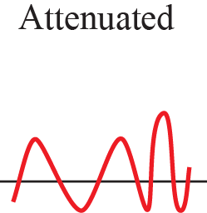
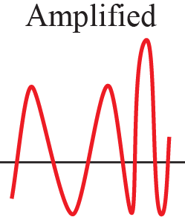
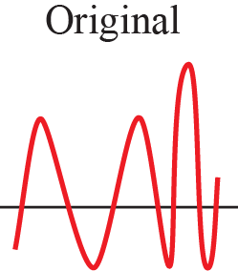
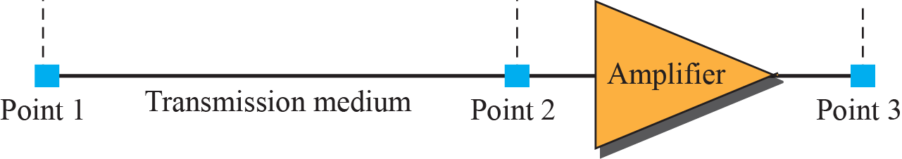
Attenuation and Amplification

Slide 31
Example 8
Suppose a signal travels through a transmission medium and its power is reduced to one half. This means that P2 = 0.5 P1. In this case, the attenuation (loss of power) can be calculated as
A loss of 3 dB (−3 dB) is equivalent to losing one-half the power.

Slide 32

Example 9
A signal travels through an amplifier, and its power is increased 10 times. This means that P₂ = 10P₁. In this case, the amplification (gain of power) can be calculated as

Slide 33
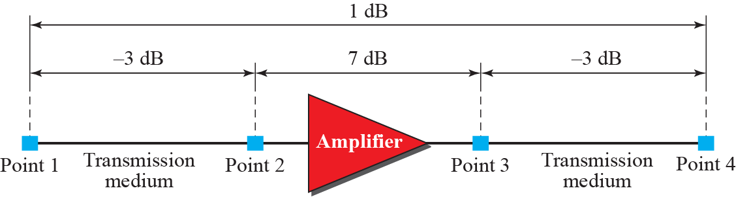
Example 10
Question on next slide

Slide 34

Example 10 Continued….
One reason that engineers use the decibel to measure the changes in the strength of a signal is that decibel numbers can be added (or subtracted) when we are measuring several points (cascading) instead of just two. In Figure 3.28 a signal travels from point 1 to point 4. The signal is attenuated by the time it reaches point 2. Between points 2 and 3, the signal is amplified. Again, between points 3 and 4, the signal is attenuated. We can find the resultant decibel value for the signal just by adding the decibel measurements between each set of points. In this case, the decibel value can be calculated as

Slide 35
Example 11
Sometimes the decibel is used to measure signal power in milliwatts. In this case, it is referred to as dB_{m} and is calculated as dB_{m} = 10 log10 Pm, where Pm is the power in milliwatts. Calculate the power of a signal if its dB_{m} = −30.
Solution
We can calculate the power in the signal as

Slide 36
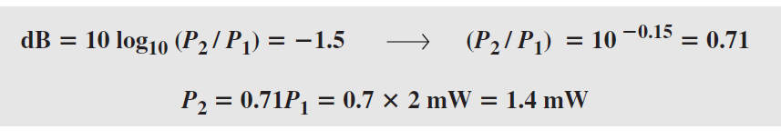
Example 12
The loss in a cable is usually defined in decibels per kilometer (dB/km). If the signal at the beginning of a cable with −0.3 dB/km has a power of 2 mW, what is the power of the signal at 5 km?
Solution
The loss in the cable in decibels is 5 × (−0.3) = −1.5 dB. We can calculate the power as

Slide 37
Distortion
Distortion means that the signal changes its form or shape. Distortion can occur in a composite signal made of different frequencies. Each signal component has its own propagation speed through a medium and, therefore, its own delay in arriving at the final destination. Differences in delay may create a difference in phase if the delay is not exactly the same as the period duration.

Slide 38
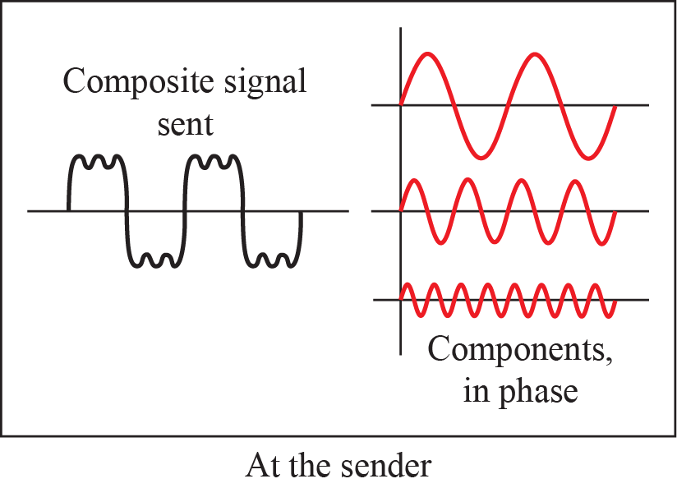
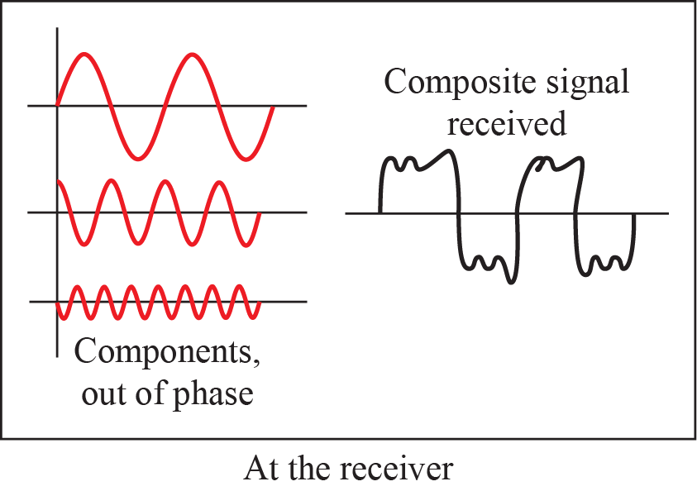
Distortion

Slide 39
Noise
Noise is another cause of impairment. Several types of noise, such as thermal noise, induced noise, crosstalk, and impulse noise, may corrupt the signal. Thermal noise is the random motion of electrons in a wire, which creates an extra signal not originally sent by the transmitter. Induced noise comes from sources such as motors. Crosstalk is the effect of one wire on the other.
Noise is measured in terms of SNR ( Signal to Noise Ratio)
SNR= Average Signal Power / Average Noise Power

Slide 40
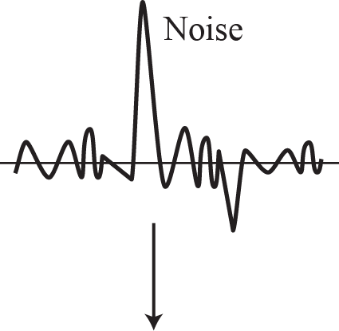
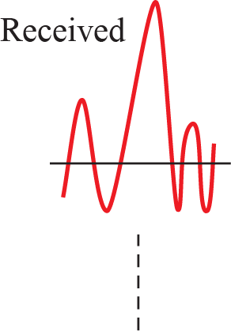
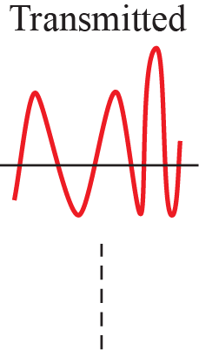
Noise

Slide 41
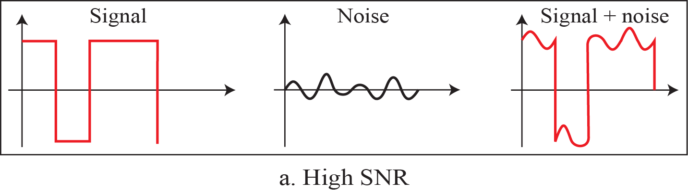
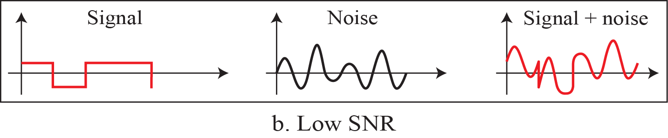
Two cases of SNR: a high SNR and a low SNR

Slide 42
Example 13
The power of a signal is 10 mW and the power of the noise is 1 μW; what are the values of SNR and SNR_{dB}?
Solution
The values of SNR and SNR_{dB} can be calculated as follows:

Slide 43
Example 14
The values of SNR and SNR_{dB} for a noiseless channel are
Solution
The values of SNR and SNRdB for a noiseless channel are
We can never achieve this ratio in real life; it is an ideal.

Slide 44

Noiseless Channel: Nyquist Rate
For a noiseless channel, the Nyquist bit rate formula defines the theoretical maximum bit rate.

Slide 45

Example 15
Consider a noiseless channel with a bandwidth of 3000 Hz transmitting a signal with two signal levels. The maximum bit rate can be calculated as

Slide 46

Example 16
Consider the same noiseless channel transmitting a signal with four signal levels (for each level, we send 2 bits). The maximum bit rate can be calculated as

Slide 47
Noisy Channel: Shannon Capacity
In reality, we cannot have a noiseless channel; the channel is always noisy. In 1944, Claude Shannon introduced a formula, called the Shannon capacity, to determine the theoretical highest data rate for a noisy channel:

Slide 48
Example 17
Consider an extremely noisy channel in which the value of the signal-to-noise ratio is almost zero. In other words, the noise is so strong that the signal is faint. For this channel the capacity C is calculated as
This means that the capacity of this channel is zero regardless of the bandwidth. In other
words, we cannot receive any data through this channel.

Slide 49
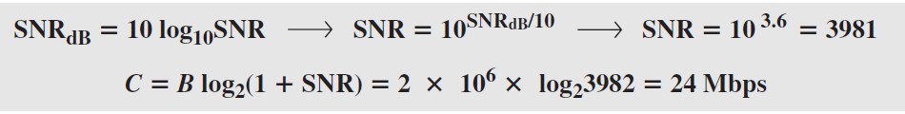
Example 18
The signal-to-noise ratio is often given in decibels. Assume that SNR_{dB} = 36 and the channel bandwidth is 2 MHz. The theoretical channel capacity can be calculated as

Slide 50

Example 19
We have a channel with a 1-MHz bandwidth. The SNR for this channel is 63. What are the appropriate bit rate and signal level?
Solution
First, we use the Shannon formula to find the upper limit.
The Shannon formula gives us 6 Mbps, the upper limit. For better performance we choose something lower, 4 Mbps. Then we use the Nyquist formula to find the number of signal levels.

Slide 51

Note
The Shannon capacity gives us the upper limit; the Nyquist formula tells us how many signal levels we need.

Slide 52
Latency or Delay
The latency or delay defines how long it takes for an entire message to completely arrive at the destination from the time the first bit is sent out from the source. We can say that latency is made of four components: propagation time, transmission time, queuing time and processing delay.

Slide 53
Propagation & Transmission delay
Propagation speed - speed at which a bit travels though the medium from source to destination.
Transmission speed - the speed at which all the bits in a message arrive at the destination. (difference in arrival time of first and last bit)
Propagation Delay = Distance/Propagation speed
Transmission Delay = Message size/bandwidth in bps
Latency = Propagation delay + Transmission delay + Queuing time + Processing time

Slide 54
Example 20
A network with bandwidth of 10 Mbps can pass only an average of 12,000 frames per minute with each frame carrying an average of 10,000 bits. What is the throughput of this network?
Solution
We can calculate the throughput as
The throughput is almost one-fifth of the bandwidth in this case.

Slide 55
Example 21
What is the propagation time if the distance between the two points is 12,000 km? Assume the propagation speed to be 2.4 × 108 m/s in cable.
Solution
We can calculate the propagation time as
The example shows that a bit can go over the Atlantic Ocean in only 50 ms if there is a direct cable between the source and the destination.

Slide 56
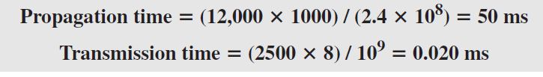
Example 22
What are the propagation time and the transmission time for a 2.5-KB (kilobyte) message if the bandwidth of the network is 1 Gbps? Assume that the distance between the sender and the receiver is 12,000 km and that light travels at 2.4 × 108 m/s.
Solution
We can calculate the propagation and transmission time as
Note that in this case, because the message is short and the bandwidth is high, the dominant factor is the propagation time, not the transmission time.

Slide 57
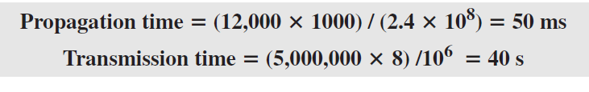
Example 23
What are the propagation time and the transmission time for a 5-MB (megabyte) message (an image) if the bandwidth of the network is 1 Mbps? Assume that the distance between the sender and the receiver is 12,000 km and that light travels at 2.4 × 108 m/s.
Solution
We can calculate the propagation and transmission times as
We can calculate the propagation and transmission times as

Slide 58
Bandwidth
One characteristic that measures network performance is bandwidth. However, the term can be used in two different contexts with two different measuring values: bandwidth in hertz and bandwidth in bits per second..

Slide 59
Bandwidth
In networking, we use the term bandwidth in two contexts.
The first, bandwidth in hertz, refers to the range of frequencies in a composite signal or the range of frequencies that a channel can pass.
The second, bandwidth in bits per second, refers to the speed of bit transmission in a channel or link. Often referred to as Capacity.

Slide 60
Throughput
The throughput is a measure of how fast we can actually send data through a network. Although, at first glance, bandwidth in bits per second and throughput seem the same, they are different. A link may have a bandwidth of B bps, but we can only send T bps through this link with T always less than B.

Slide 61
Bandwidth-Delay Product
Bandwidth and delay are two performance metrics of a link. However, as we will see in this chapter and future chapters, what is very important in data communications is the product of the two, the bandwidth-delay product. Let us elaborate on this issue, using two hypothetical cases as examples.

Slide 62



Concept of bandwidth-delay product

Slide 63
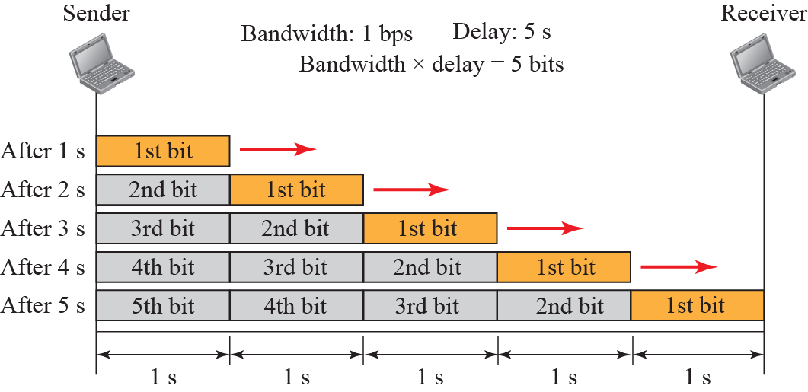
Filling the links with bits for Case 1

Slide 64
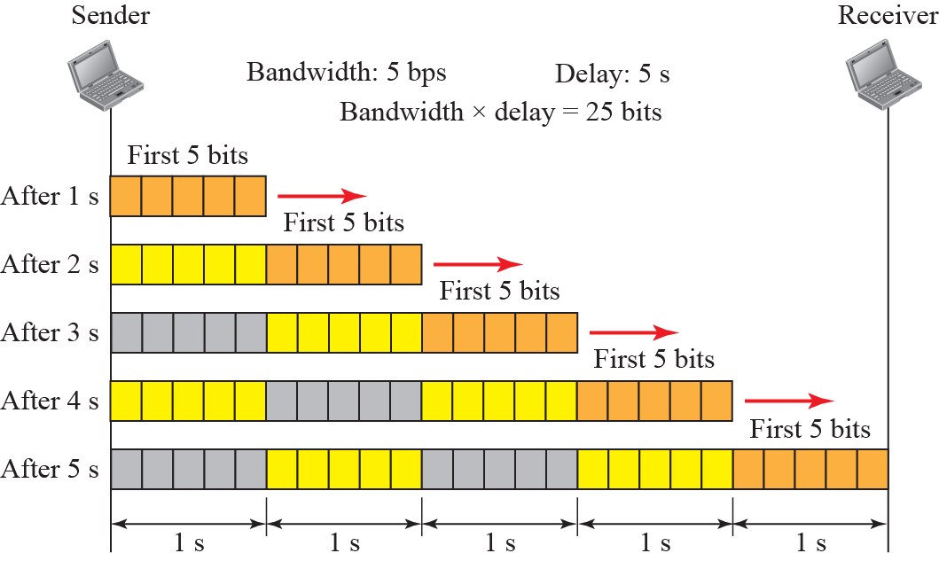
Filling the pipe with bits for Case 2

Slide 65
Thank You
Discussion & Doubt session will be in lecture.
Important terms to keep in mind
  Analog & Digital Signal
  Simple Composite Signal
  Nyquist & Shannon capacity
  Transmission Impairment
  Latency
  Bandwidth (Hz/ bps)

